Slide 1


Bitcoin & Ethereum
By: Kevin Ortega

Slide 2
Objective
Explore the potential benefits of investing in Bitcoin and Ethereum for the long term, based on factors such as their growing mainstream adoption and potential for diversification in an investment portfolio.

Slide 3
Methodology
Bitcoin and Ethereum price data set from 2014-2023
Use Tableau to organize data and remove unnecessary column
Create Visuals on BTC and ETH pricing
Make Recommendation
I came across a few challenges, the data sets have some empty values and caused some errors, I had to fill those with averages from prices
Creating some visuals, the picture would not display the right data
Errors within the code, I had to find some alternatives online.

Slide 4
What is Bitcoin
Bitcoin was created in 2009, the created is unknown
Bitcoin operates on a decentralized system, meaning that it is not controlled by any government or financial institution
Bitcoin's supply is limited to 21 million coins, which means that it is a deflationary currency
Transactions on the Bitcoin network are verified by a network of users, called nodes
Notes:
Ethereum was created in 2015 by a programmer named Vitalik Buterin
It is the second-largest cryptocurrency by market capitalization after Bitcoin
Ethereum is also a decentralized system that allows developers to build decentralized applications (dApps) on top of its blockchain

Slide 5
What is Ethereum
Ethereum was created in 2015 by a programmer named Vitalik Buterin
It is the second-largest cryptocurrency by market capitalization after Bitcoin
Ethereum is also a decentralized system that allows developers to build decentralized applications on top of its blockchain
Ethereum uses a consensus mechanism called Proof of Stake (PoS) to validate transactions
Notes:
It is the first and most well-known cryptocurrency in the world
Bitcoin operates on a decentralized system, meaning that it is not controlled by any government or financial institution
Transactions on the Bitcoin network are verified by a network of users, called nodes, who compete to solve complex mathematical problems in order to validate transactions
Bitcoin's supply is limited to 21 million coins, which means that it is a deflationary currency
Ethereum uses a consensus mechanism called Proof of Stake (PoS) to validate transactions, which is more energy-efficient than Bitcoin's Proof of Work (PoW) mechanism

Slide 6
Why Bitcoin and Ethereum Aren’t Being Used
There are a lot of regulatory uncertainty in the crypto world because most of it is unregulated and decentralized
There is a lack of mainstream acceptance
Using Bitcoin and Ethereum can be complex

Slide 7

Benefits of BTC and ETH
It isn’t being controlled by governments or monitored by institutions
There is potential for long-term growth
Seen as a store of value, like gold and metals
Gives you more portfolio diversification
Since there is a limited supply, the value can increase over time (100K?)

Slide 8
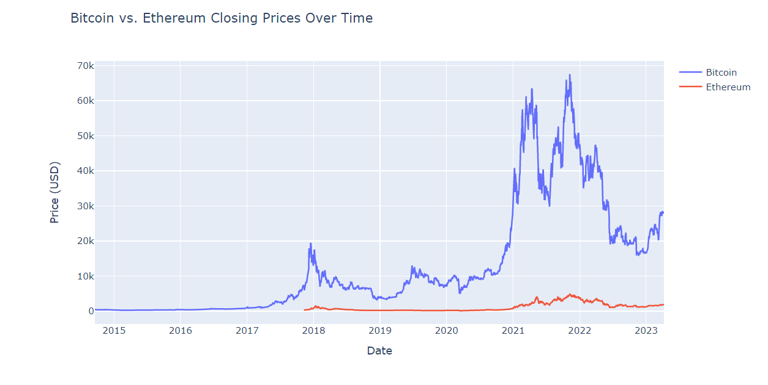
Results

Slide 9
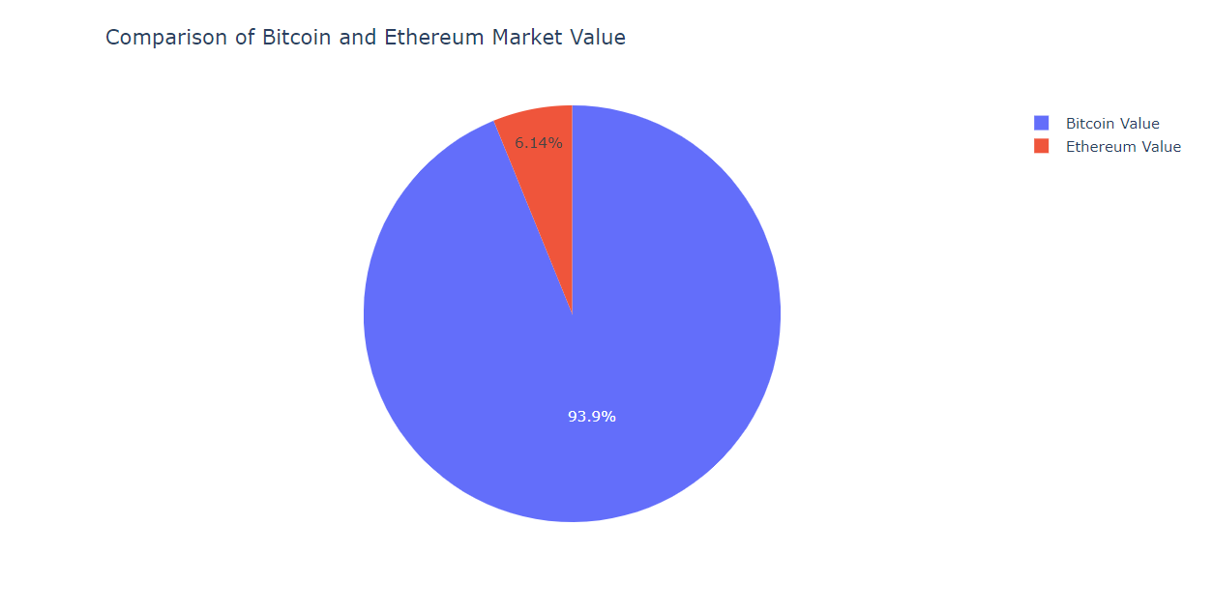
Results
Notes:
-As you can see from this chart, bitcoin holds most of the market share between the two and it is more expensive to buy so a cheaper option would ne ETH

Slide 10
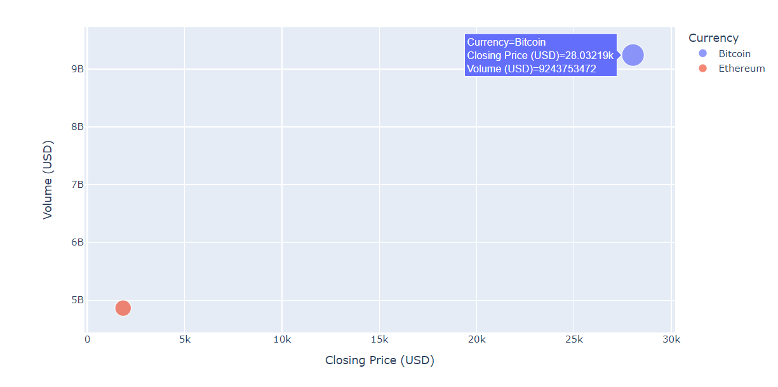
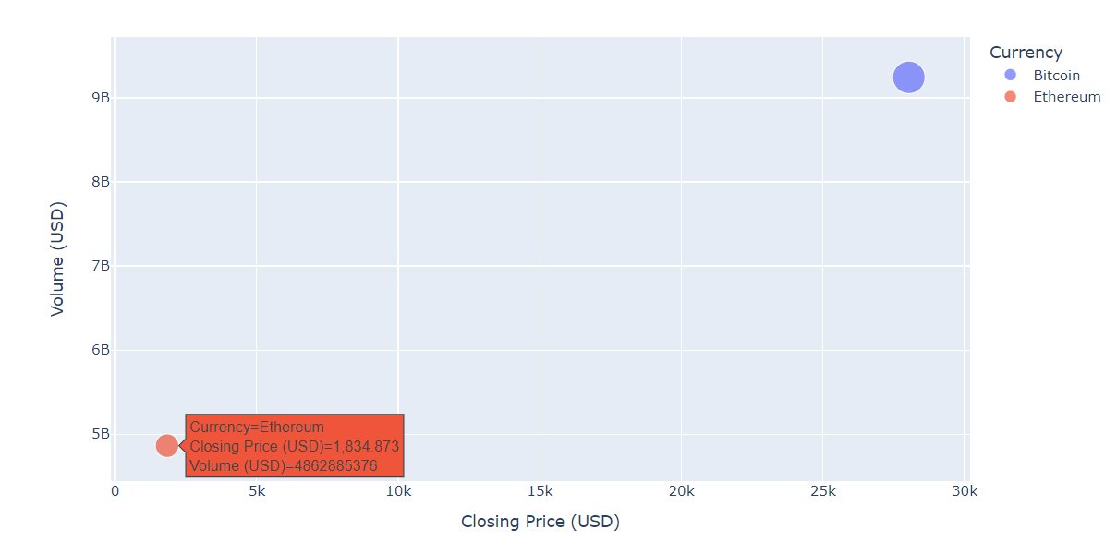
Results
Notes:
-As you can see from this chart, bitcoin holds most of the market share between the two and it is more expensive to buy so a cheaper option would ne ETH

Slide 11
Recommendations
From the data given, Bitcoin and Ethereum have lots of room to grow
As of 2023 both crypto currencies are at a good buy point
It would be a good option to diversify your portfolio

Slide 12
Future Work
Learn how to better use machine learning and predictive models to predict which direction both currencies will go in the next few years
Get more data on BTC and ETH
Prepare data and clean

Slide 13

Thank You

